Slide 1
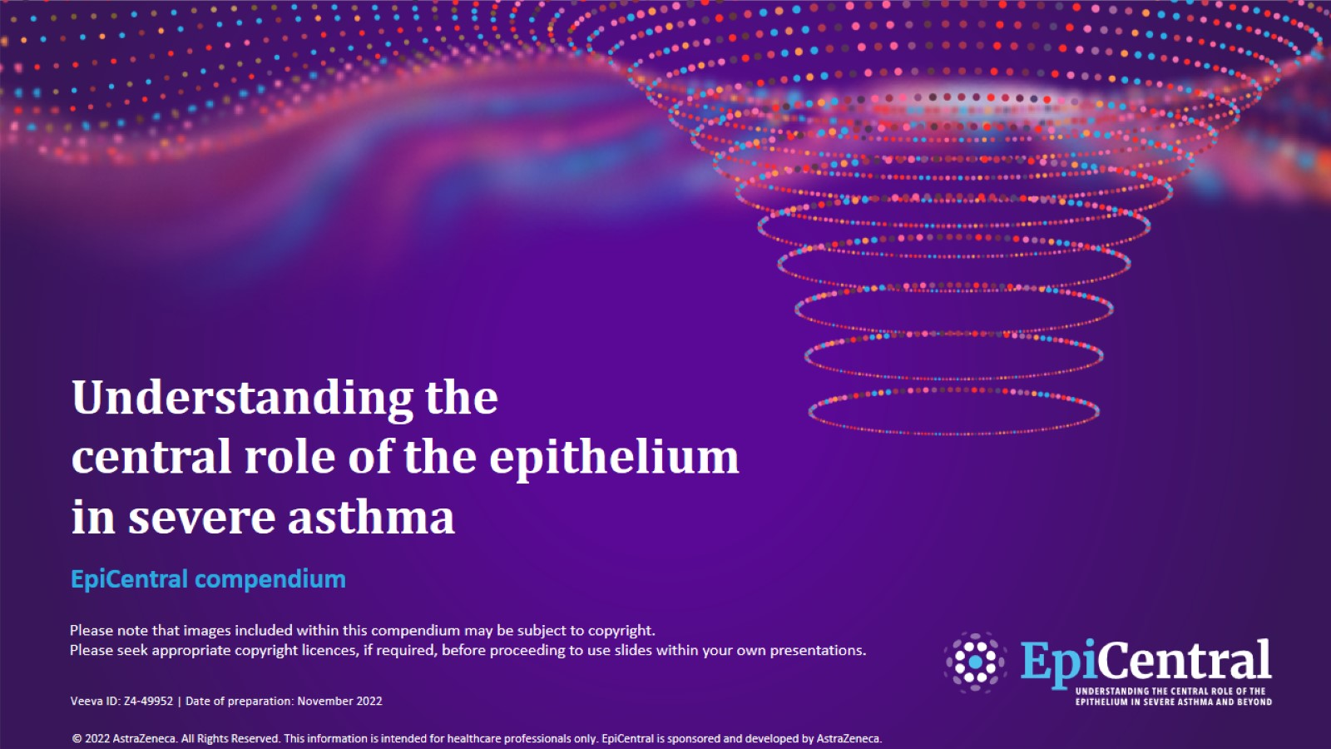
Understanding the central role of the epithelium in severe asthma
CN-142726; date of preparation: Dec 2024. © 2025 AstraZeneca. All Rights Reserved. This information is intended for healthcare professionals only. EpiCentral is sponsored and developed by Amgen and AstraZeneca.

Slide 2
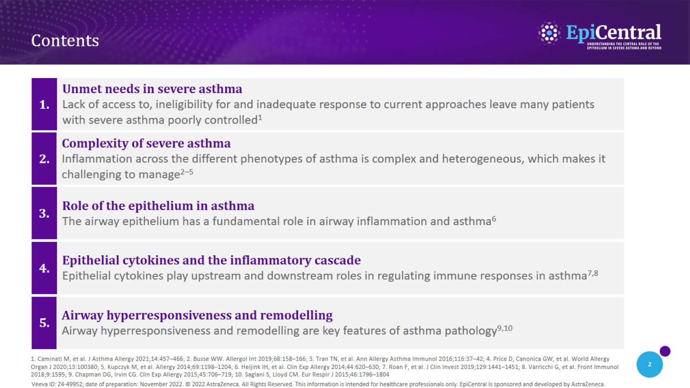
Contents
CN-142726; date of preparation: Dec 2024. © 2025 AstraZeneca. All Rights Reserved. This information is intended for healthcare professionals only. EpiCentral is sponsored and developed by Amgen and AstraZeneca.

Slide 3
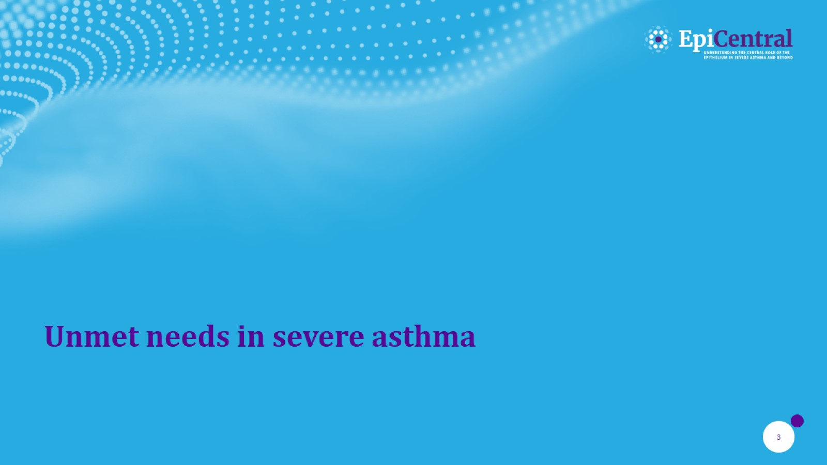
Unmet needs in severe asthma

Slide 4
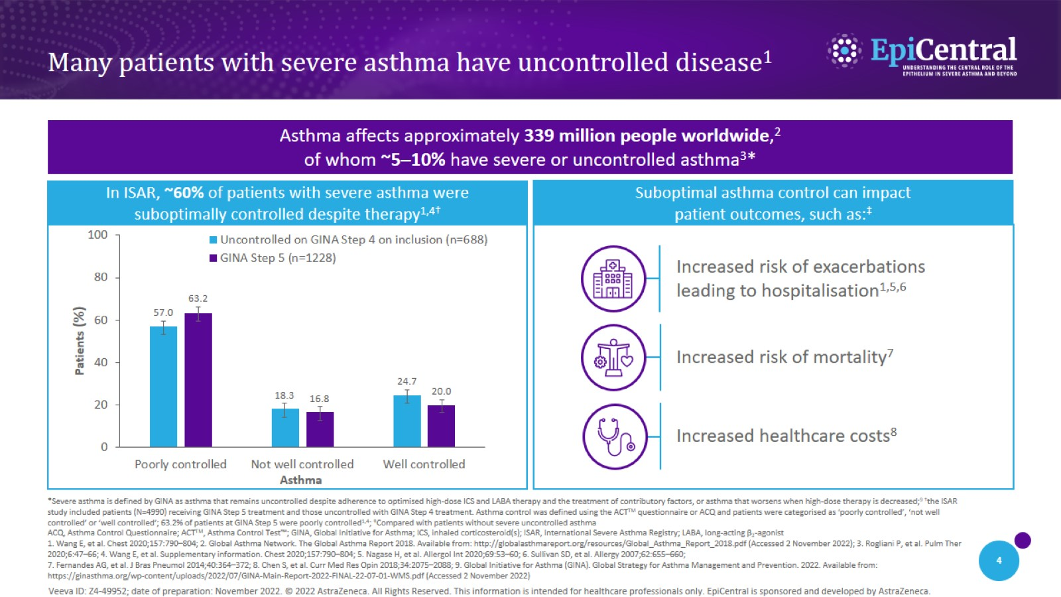
Many patients with severe asthma have uncontrolled disease¹
CN-142726; date of preparation: Dec 2024. © 2025 AstraZeneca. All Rights Reserved. This information is intended for healthcare professionals only. EpiCentral is sponsored and developed by Amgen and AstraZeneca.

Slide 5
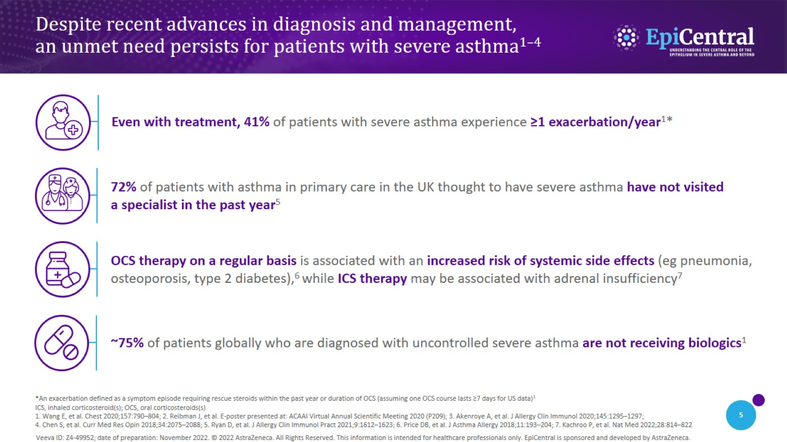
Despite recent advances in diagnosis and management, an unmet need persists for patients with severe asthma^{1–4}
CN-142726; date of preparation: Dec 2024. © 2025 AstraZeneca. All Rights Reserved. This information is intended for healthcare professionals only. EpiCentral is sponsored and developed by Amgen and AstraZeneca.

Slide 6
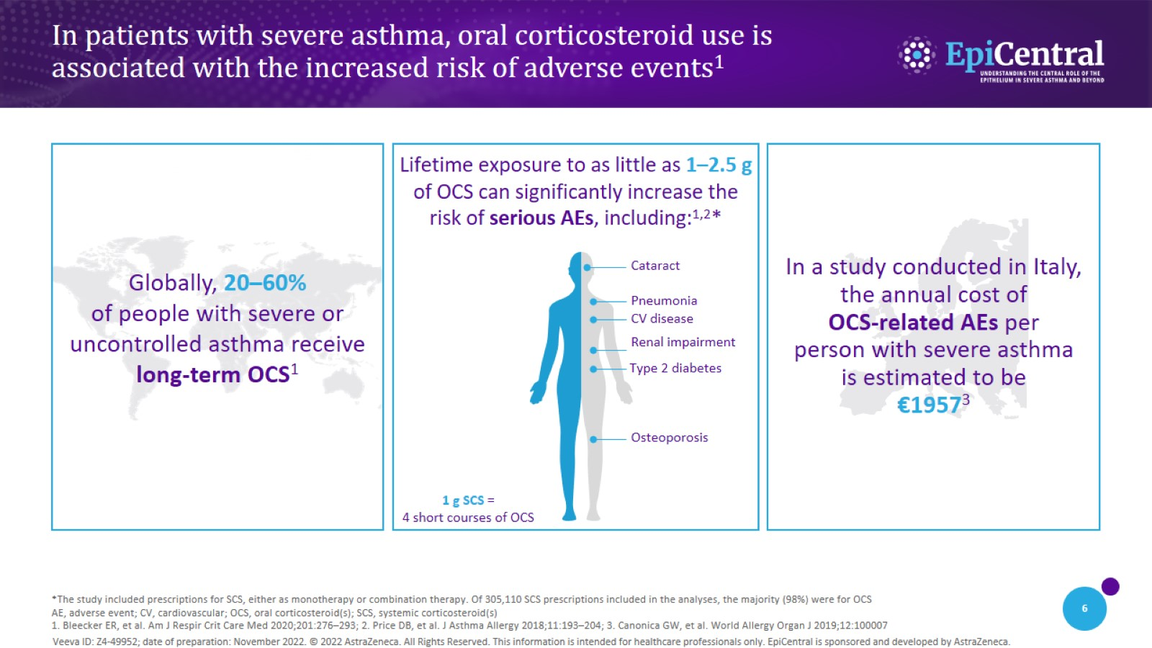
In patients with severe asthma, oral corticosteroid use is associated with the increased risk of adverse events¹
CN-142726; date of preparation: Dec 2024. © 2025 AstraZeneca. All Rights Reserved. This information is intended for healthcare professionals only. EpiCentral is sponsored and developed by Amgen and AstraZeneca.

Slide 7
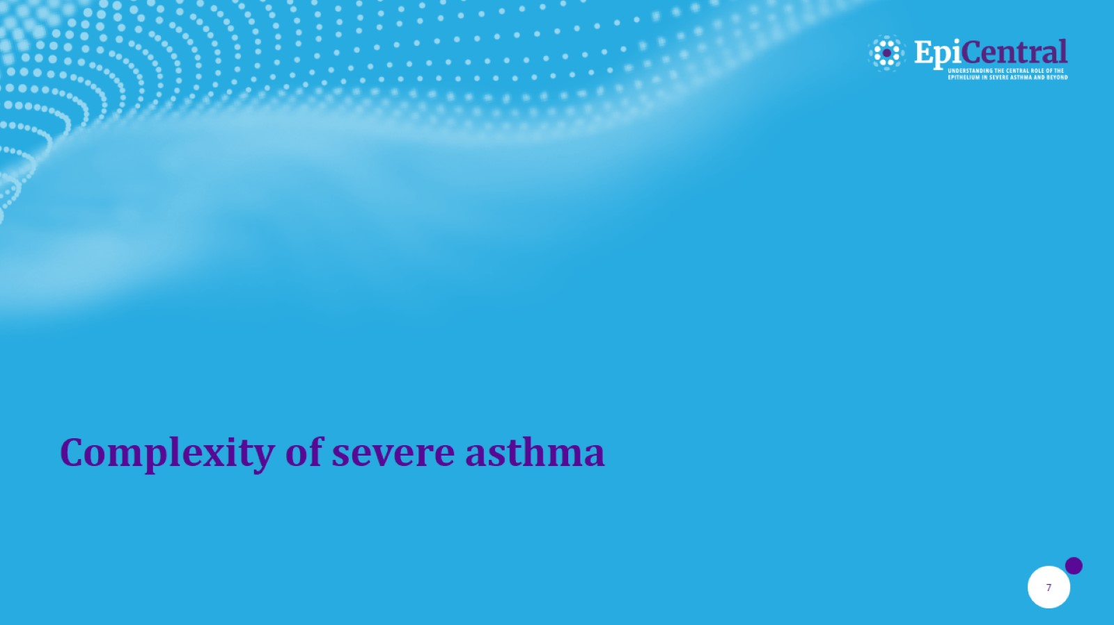
Complexity of severe asthma

Slide 8
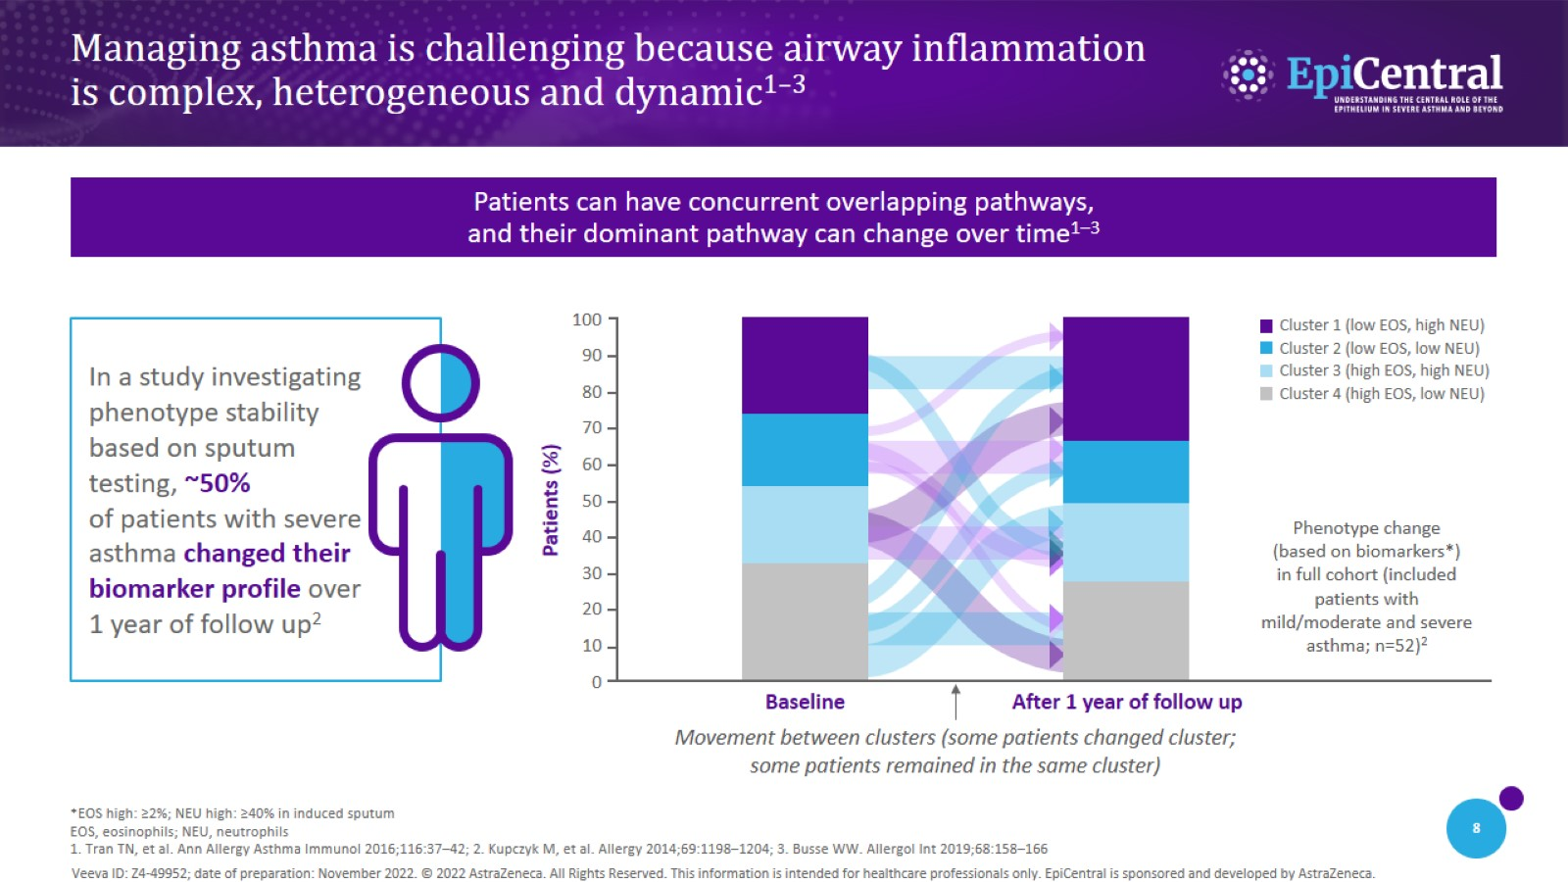
Managing asthma is challenging because airway inflammation is complex, heterogeneous and dynamic^{1–3}
CN-142726; date of preparation: Dec 2024. © 2025 AstraZeneca. All Rights Reserved. This information is intended for healthcare professionals only. EpiCentral is sponsored and developed by Amgen and AstraZeneca.

Slide 9
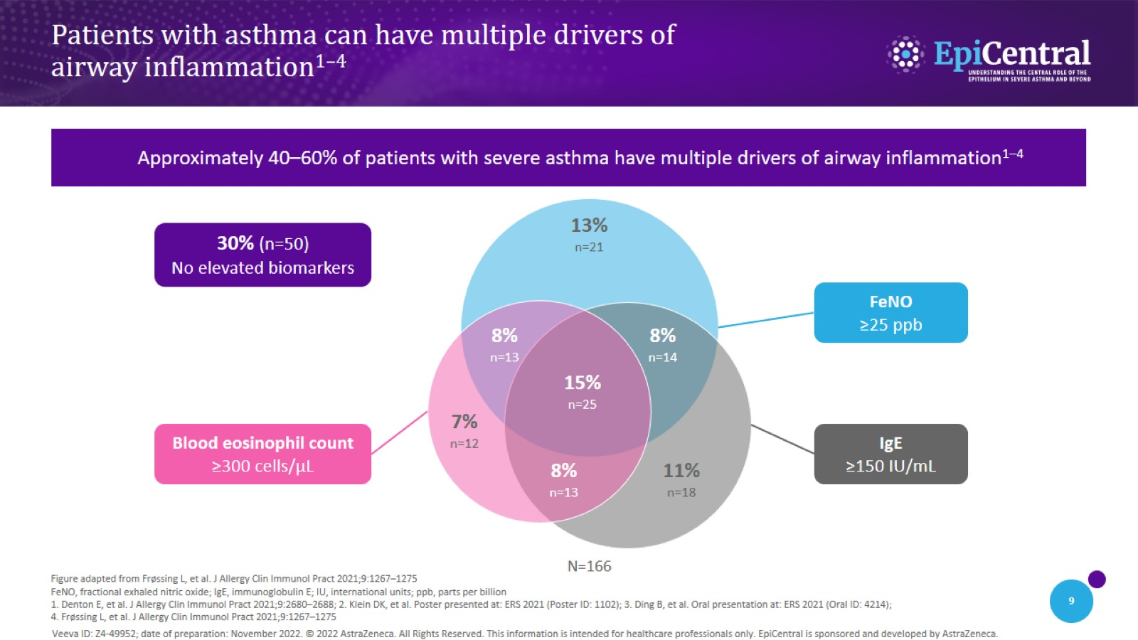
Patients with asthma can have multiple drivers of airway inflammation^{1–4}
CN-142726; date of preparation: Dec 2024. © 2025 AstraZeneca. All Rights Reserved. This information is intended for healthcare professionals only. EpiCentral is sponsored and developed by Amgen and AstraZeneca.

Slide 10
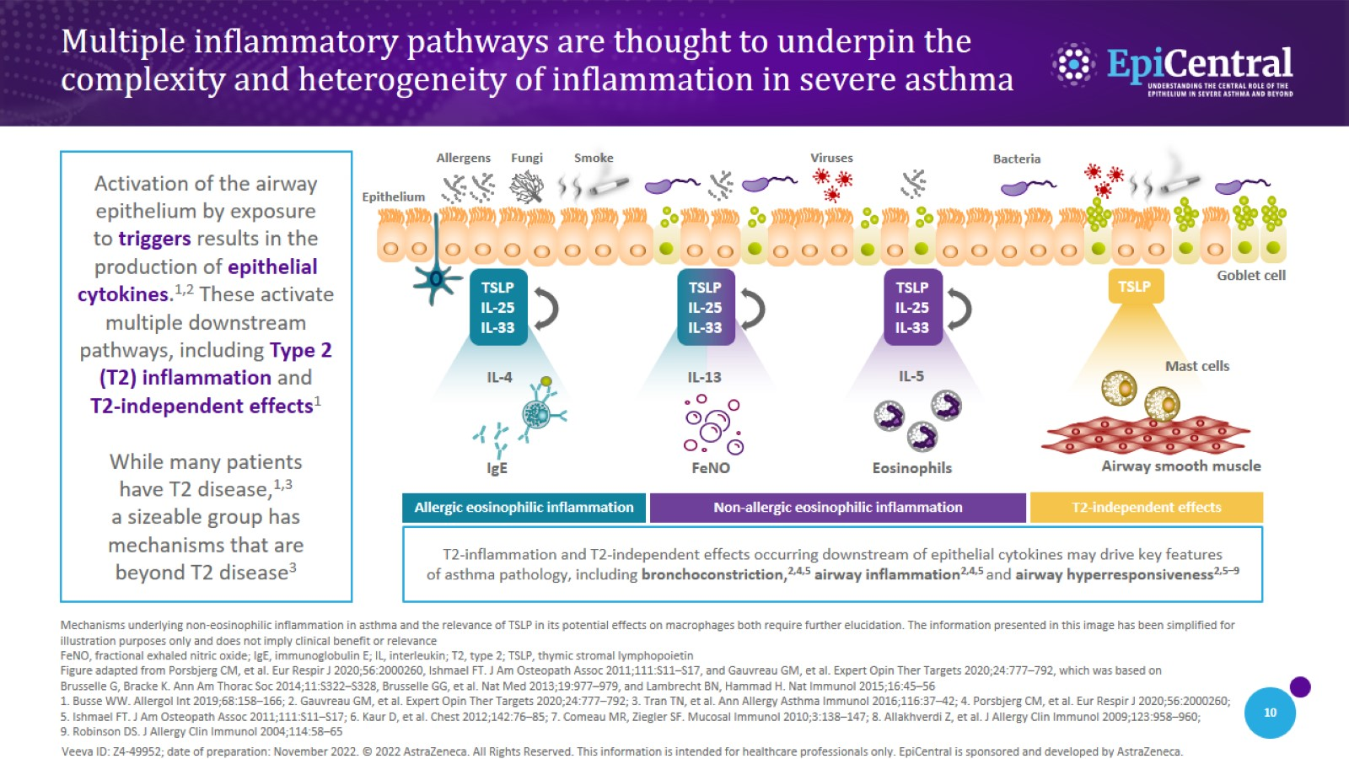
Multiple inflammatory pathways are thought to underpin the complexity and heterogeneity of inflammation in severe asthma
CN-142726; date of preparation: Dec 2024. © 2025 AstraZeneca. All Rights Reserved. This information is intended for healthcare professionals only. EpiCentral is sponsored and developed by Amgen and AstraZeneca.

Slide 11
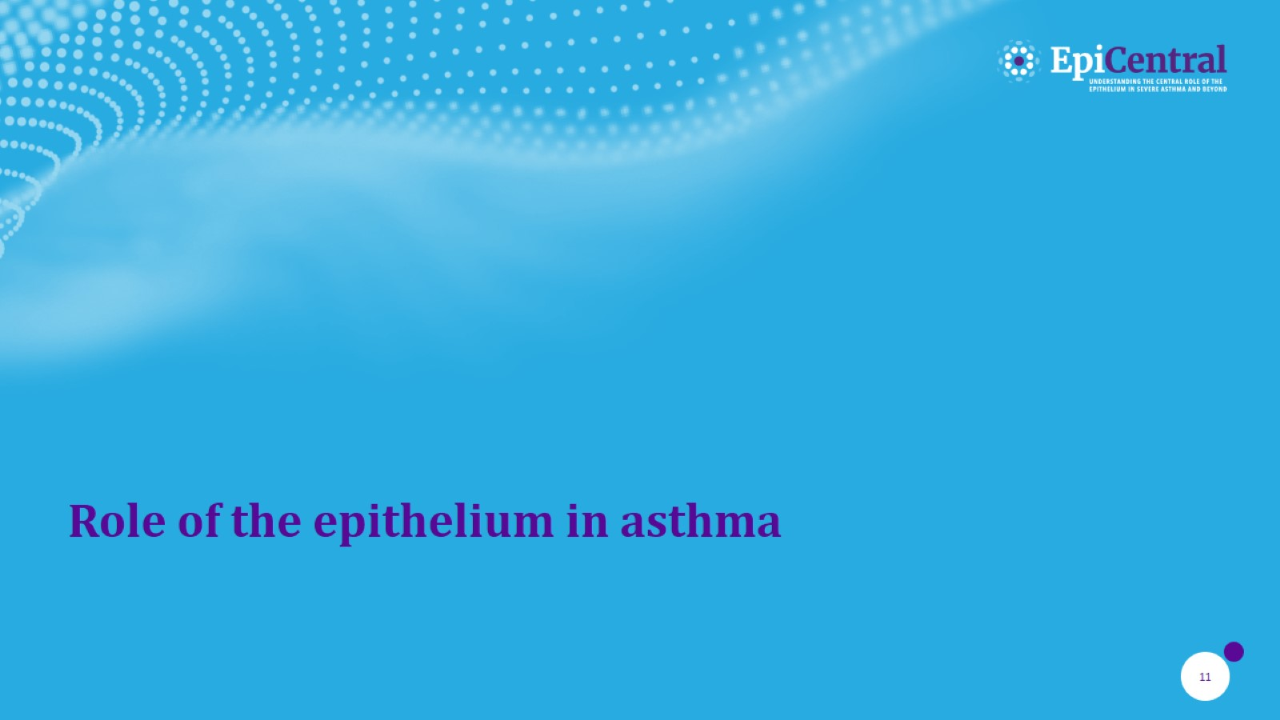
Role of the epithelium in asthma

Slide 12
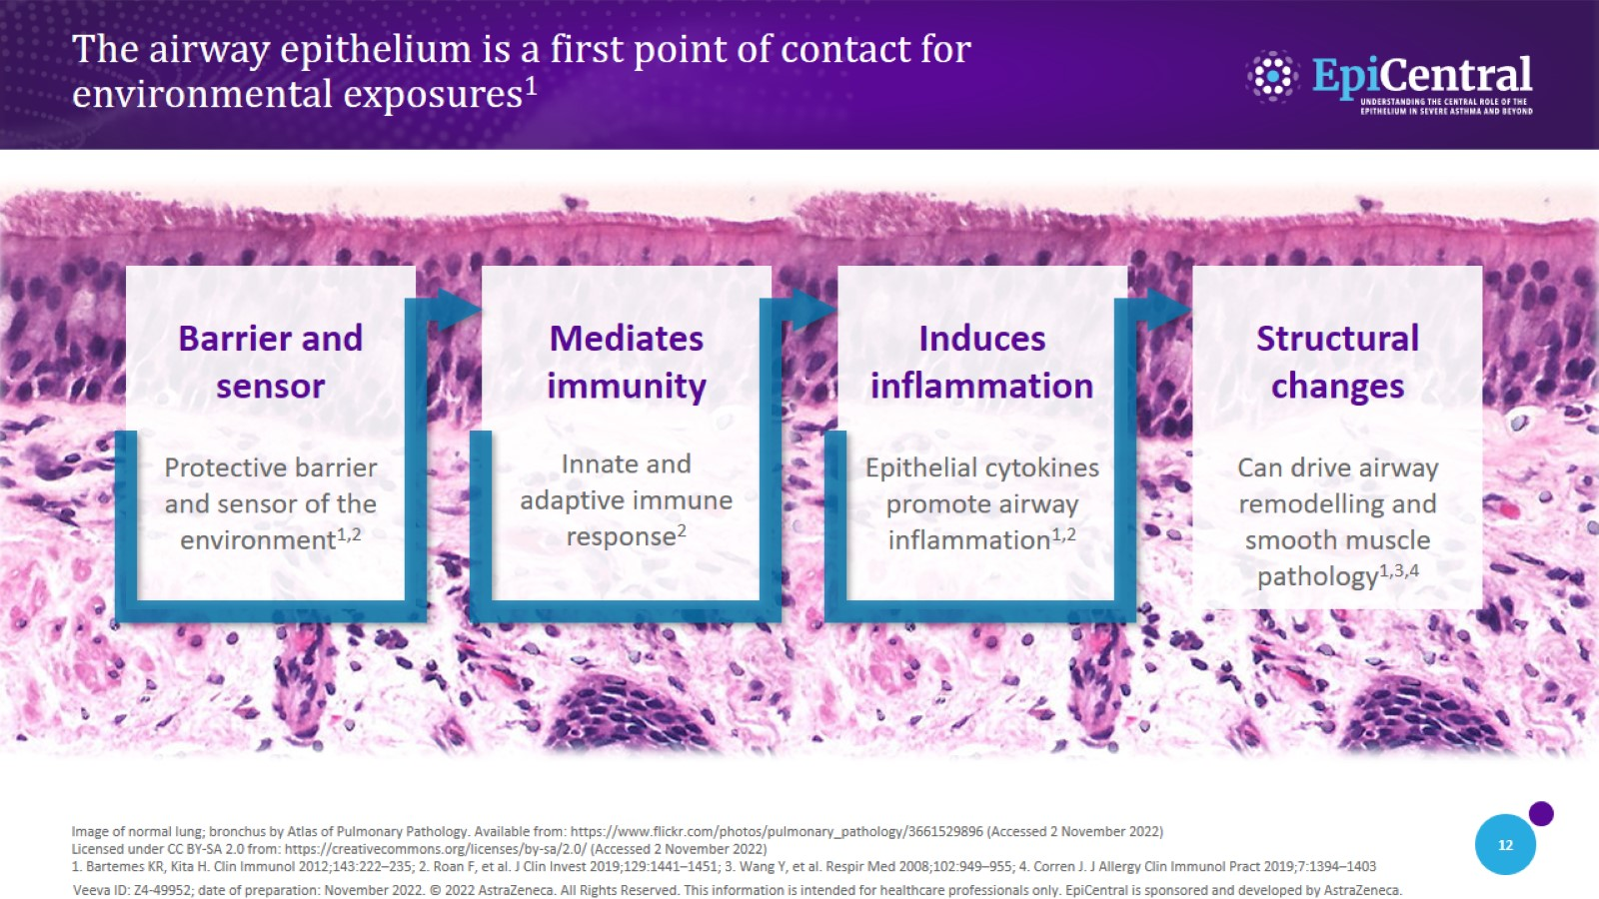
The airway epithelium is a first point of contact for environmental exposures¹
CN-142726; date of preparation: Dec 2024. © 2025 AstraZeneca. All Rights Reserved. This information is intended for healthcare professionals only. EpiCentral is sponsored and developed by Amgen and AstraZeneca.

Slide 13
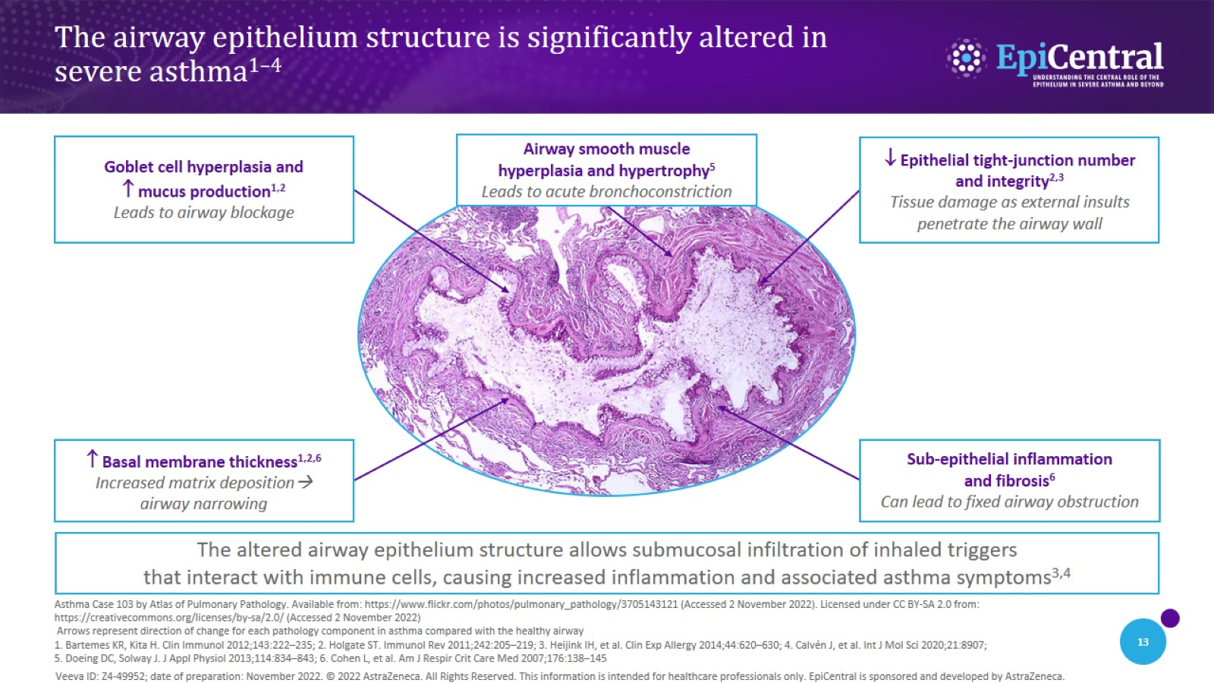
The airway epithelium structure is significantly altered in severe asthma^{1–4}
CN-142726; date of preparation: Dec 2024. © 2025 AstraZeneca. All Rights Reserved. This information is intended for healthcare professionals only. EpiCentral is sponsored and developed by Amgen and AstraZeneca.

Slide 14
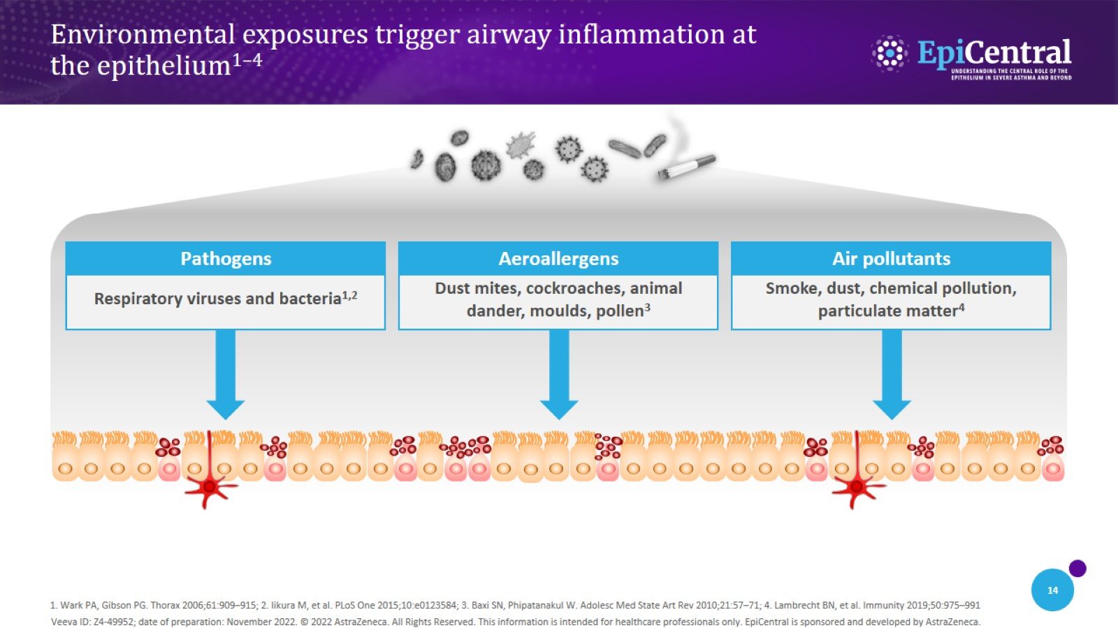
Environmental exposures trigger airway inflammation at the epithelium^{1–4}
CN-142726; date of preparation: Dec 2024. © 2025 AstraZeneca. All Rights Reserved. This information is intended for healthcare professionals only. EpiCentral is sponsored and developed by Amgen and AstraZeneca.

Slide 15
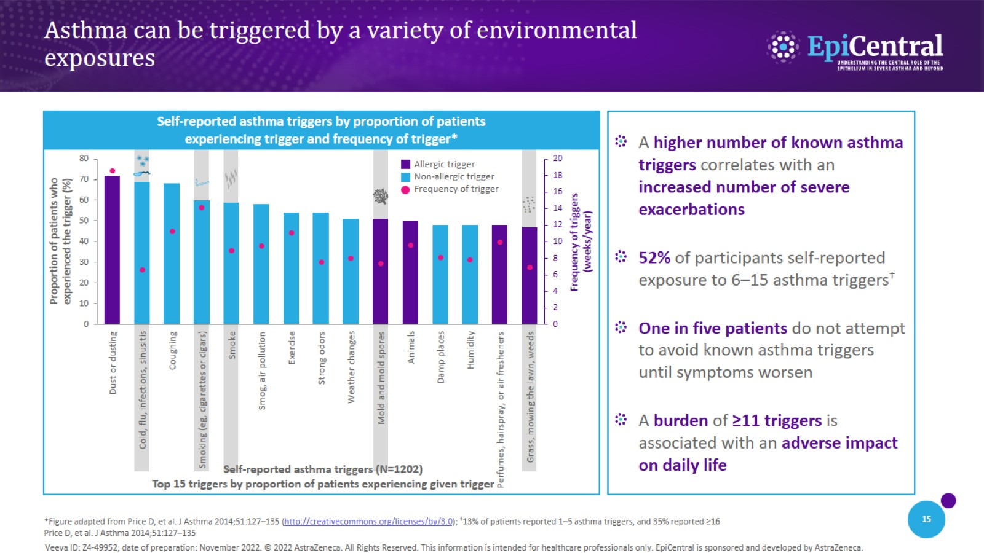
Asthma can be triggered by a variety of environmental exposures
CN-142726; date of preparation: Dec 2024. © 2025 AstraZeneca. All Rights Reserved. This information is intended for healthcare professionals only. EpiCentral is sponsored and developed by Amgen and AstraZeneca.

Slide 16

Epithelial cytokines and the inflammatory cascade

Slide 17
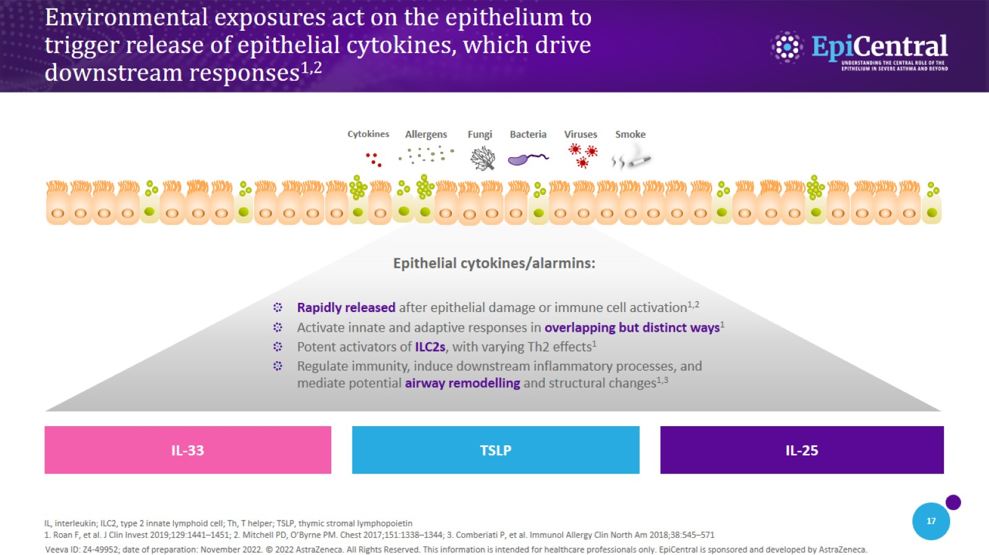
Environmental exposures act on the epithelium to trigger release of epithelial cytokines, which drive downstream responses^{1,2}
CN-142726; date of preparation: Dec 2024. © 2025 AstraZeneca. All Rights Reserved. This information is intended for healthcare professionals only. EpiCentral is sponsored and developed by Amgen and AstraZeneca.

Slide 18
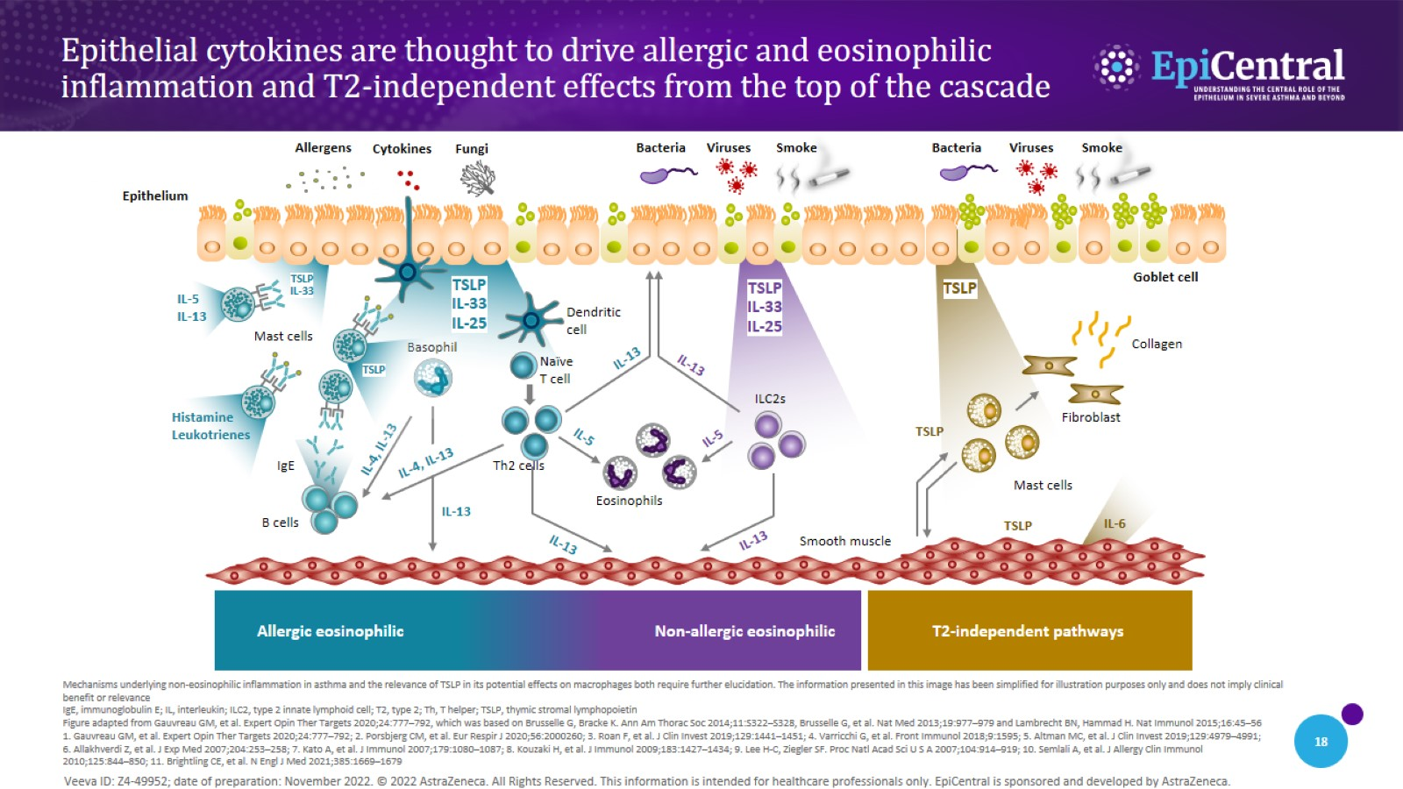
Epithelial cytokines are thought to drive allergic and eosinophilic inflammation and T2-independent effects from the top of the cascade
CN-142726; date of preparation: Dec 2024. © 2025 AstraZeneca. All Rights Reserved. This information is intended for healthcare professionals only. EpiCentral is sponsored and developed by Amgen and AstraZeneca.

Slide 19
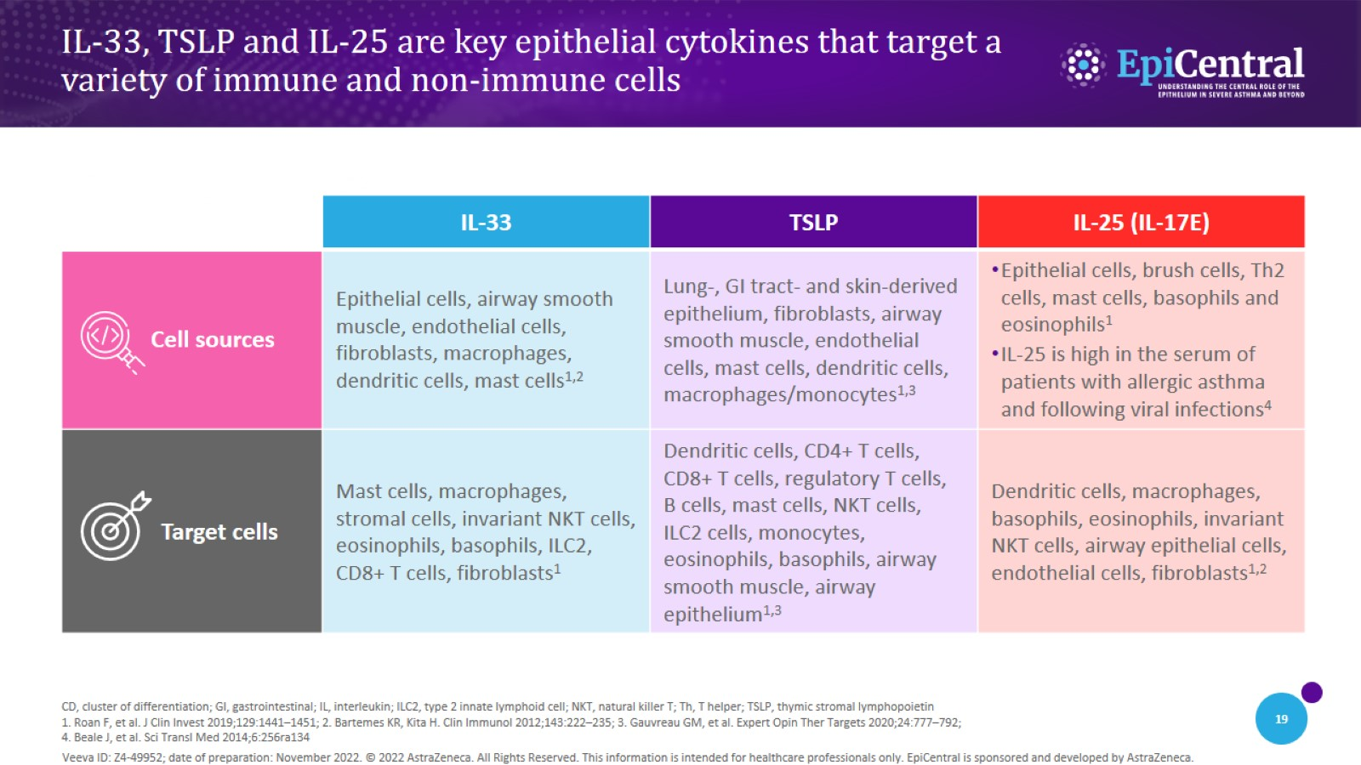
IL-33, TSLP and IL-25 are key epithelial cytokines that target a variety of immune and non-immune cells
CN-142726; date of preparation: Dec 2024. © 2025 AstraZeneca. All Rights Reserved. This information is intended for healthcare professionals only. EpiCentral is sponsored and developed by Amgen and AstraZeneca.

Slide 20
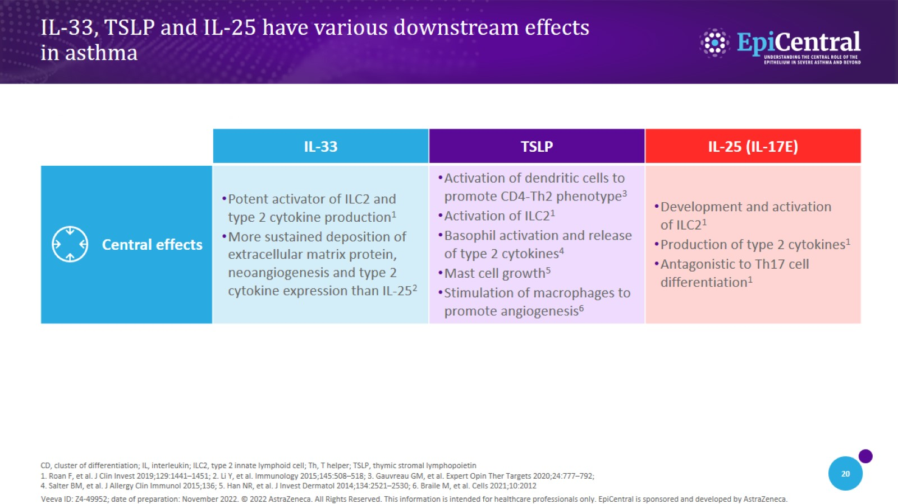
IL-33, TSLP and IL-25 have various downstream effects in asthma
CN-142726; date of preparation: Dec 2024. © 2025 AstraZeneca. All Rights Reserved. This information is intended for healthcare professionals only. EpiCentral is sponsored and developed by Amgen and AstraZeneca.

Slide 21
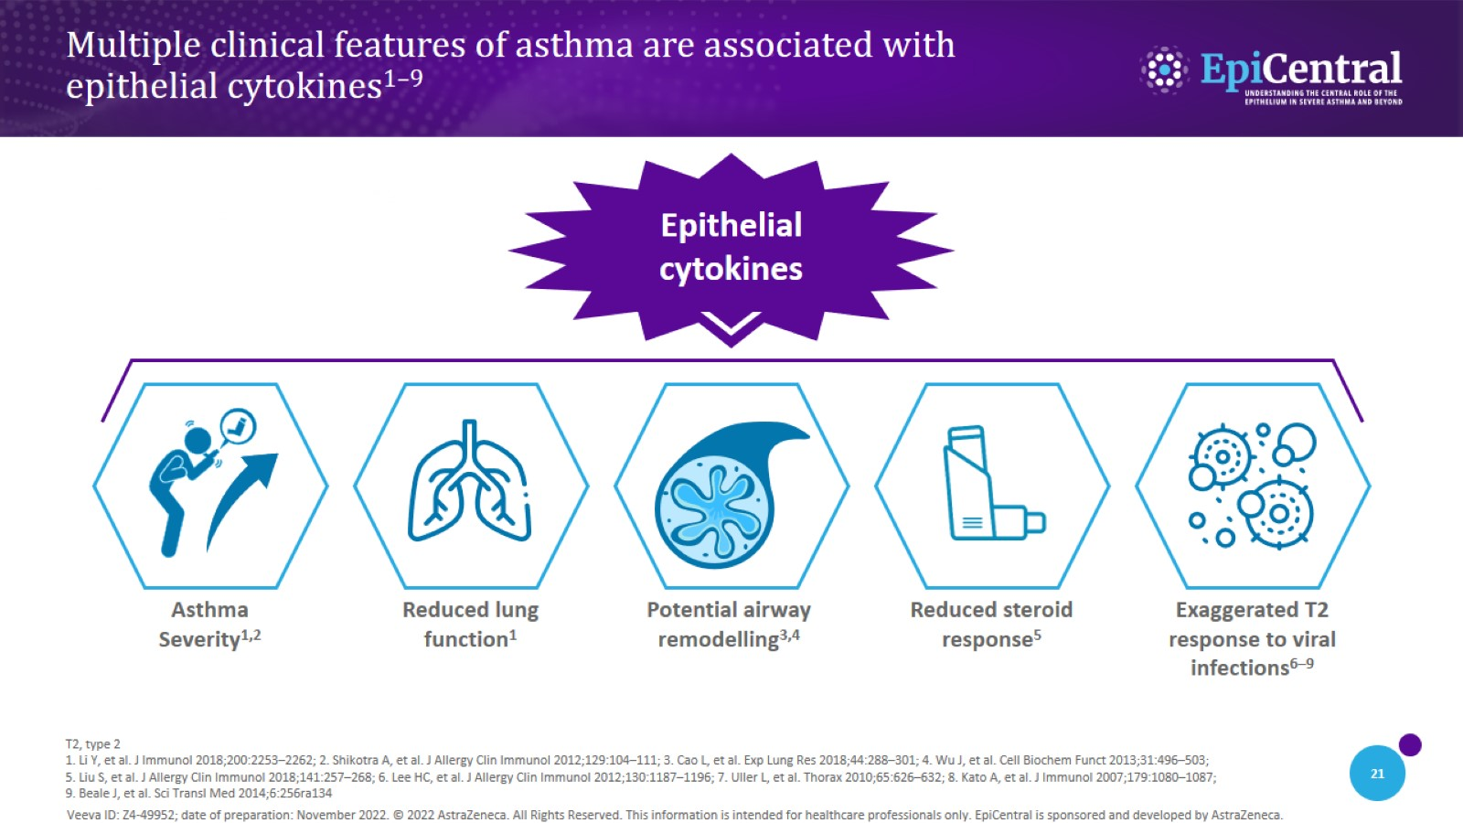
Multiple clinical features of asthma are associated with epithelial cytokines^{1–9}
CN-142726; date of preparation: Dec 2024. © 2025 AstraZeneca. All Rights Reserved. This information is intended for healthcare professionals only. EpiCentral is sponsored and developed by Amgen and AstraZeneca.

Slide 22
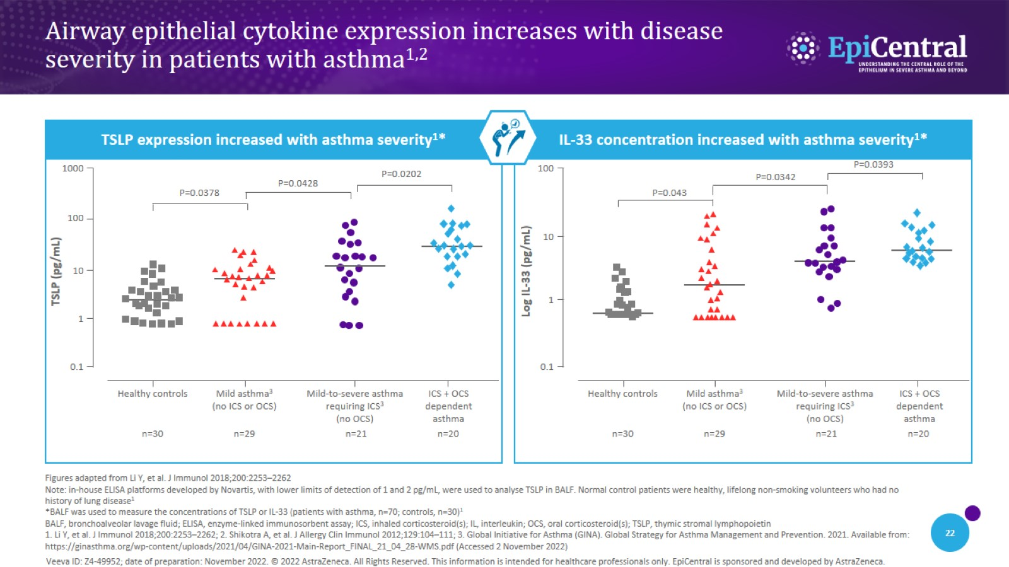
Airway epithelial cytokine expression increases with disease severity in patients with asthma^{1,2}
CN-142726; date of preparation: Dec 2024. © 2025 AstraZeneca. All Rights Reserved. This information is intended for healthcare professionals only. EpiCentral is sponsored and developed by Amgen and AstraZeneca.

Slide 23
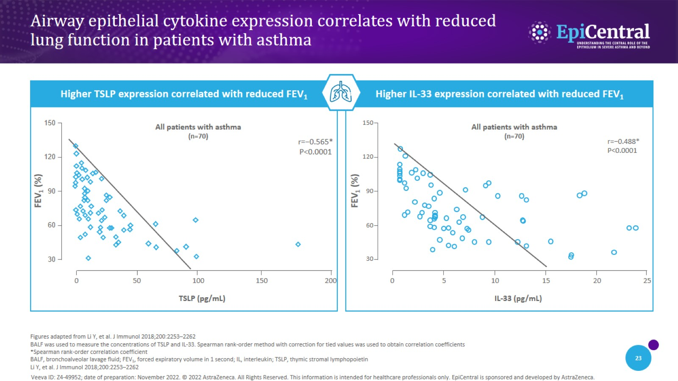
Airway epithelial cytokine expression correlates with reduced lung function in patients with asthma
CN-142726; date of preparation: Dec 2024. © 2025 AstraZeneca. All Rights Reserved. This information is intended for healthcare professionals only. EpiCentral is sponsored and developed by Amgen and AstraZeneca.

Slide 24
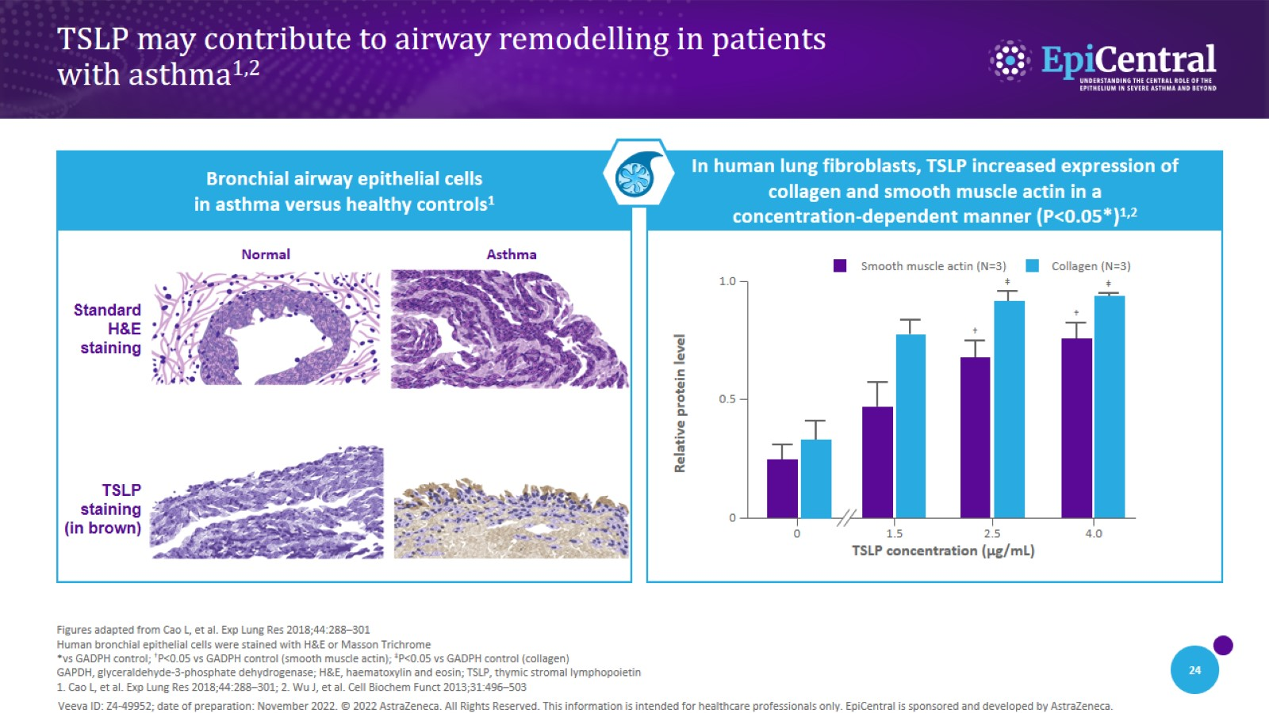
TSLP may contribute to airway remodelling in patients with asthma^{1,2}
CN-142726; date of preparation: Dec 2024. © 2025 AstraZeneca. All Rights Reserved. This information is intended for healthcare professionals only. EpiCentral is sponsored and developed by Amgen and AstraZeneca.

Slide 25
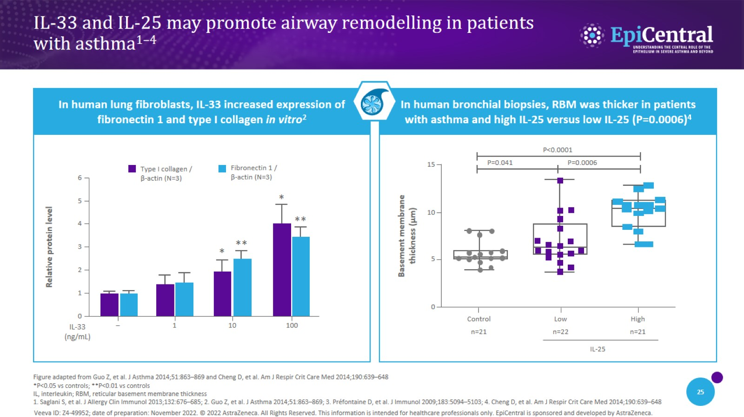
IL-33 and IL-25 may promote airway remodelling in patients with asthma^{1–4}
CN-142726; date of preparation: Dec 2024. © 2025 AstraZeneca. All Rights Reserved. This information is intended for healthcare professionals only. EpiCentral is sponsored and developed by Amgen and AstraZeneca.

Slide 26
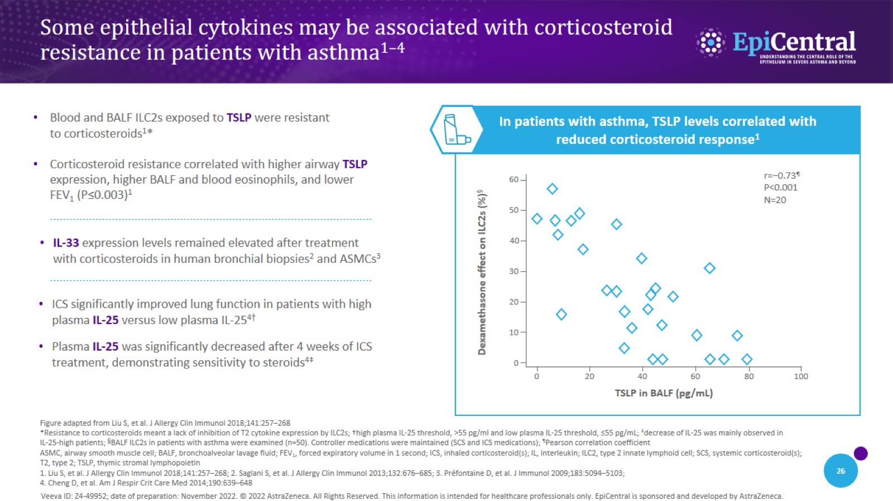
Some epithelial cytokines may be associated with corticosteroid resistance in patients with asthma^{1–4}
CN-142726; date of preparation: Dec 2024. © 2025 AstraZeneca. All Rights Reserved. This information is intended for healthcare professionals only. EpiCentral is sponsored and developed by Amgen and AstraZeneca.

Slide 27
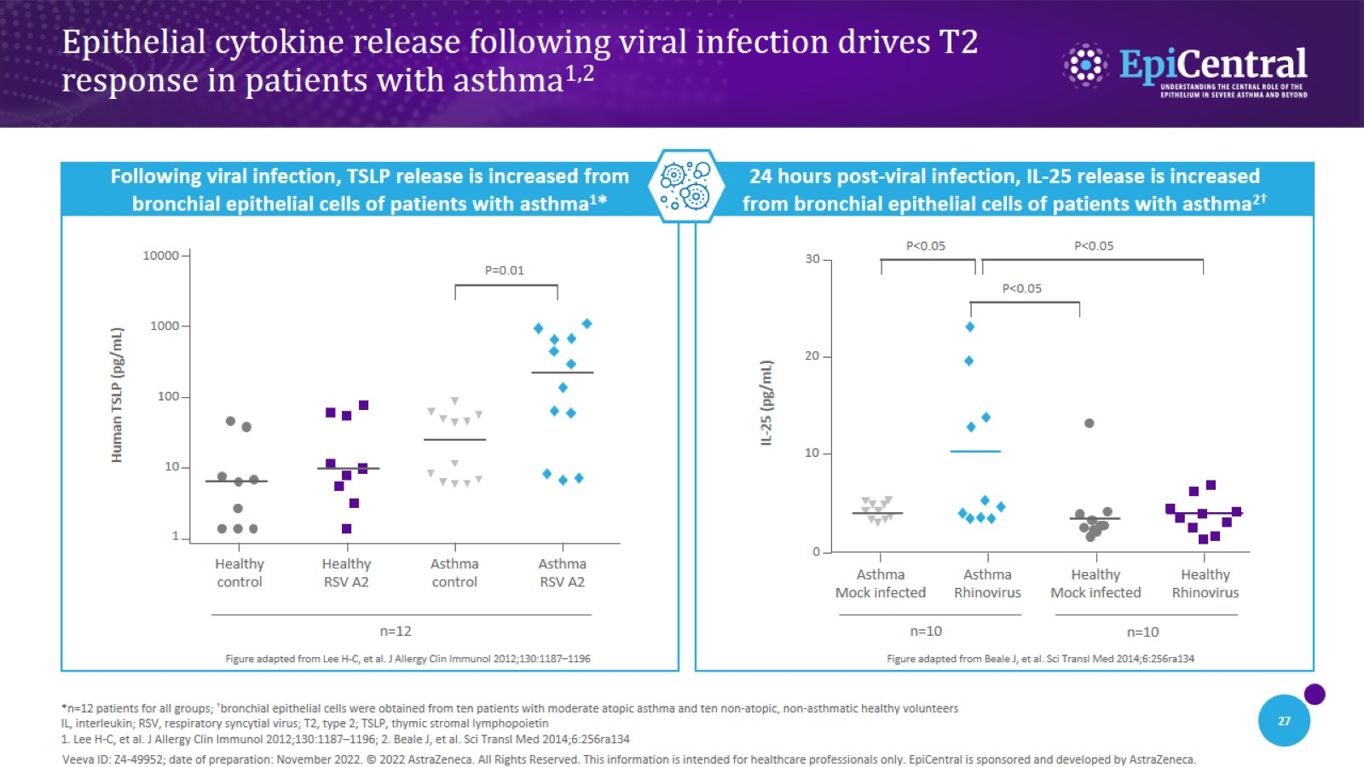
Epithelial cytokine release following viral infection drives T2 response in patients with asthma^{1,2}
CN-142726; date of preparation: Dec 2024. © 2025 AstraZeneca. All Rights Reserved. This information is intended for healthcare professionals only. EpiCentral is sponsored and developed by Amgen and AstraZeneca.

Slide 28

Airway hyperresponsiveness and remodelling

Slide 29
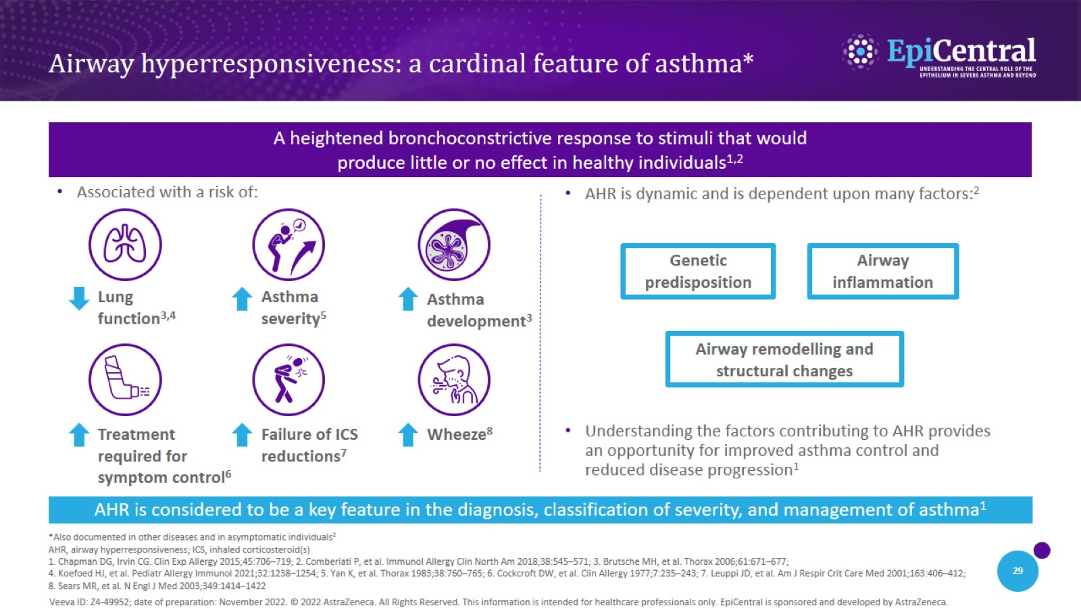
Airway hyperresponsiveness: a cardinal feature of asthma*
CN-142726; date of preparation: Dec 2024. © 2025 AstraZeneca. All Rights Reserved. This information is intended for healthcare professionals only. EpiCentral is sponsored and developed by Amgen and AstraZeneca.

Slide 30
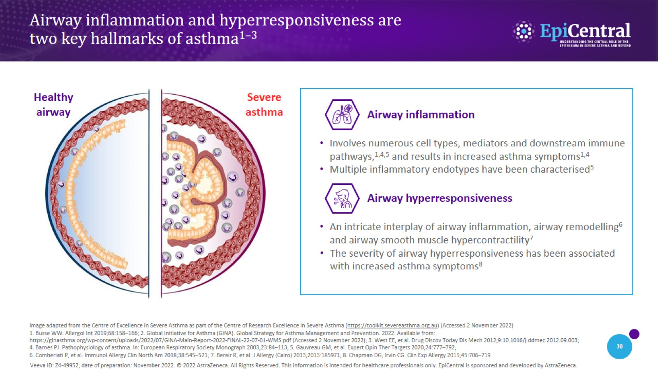
Airway inflammation and hyperresponsiveness are two key hallmarks of asthma^{1–3}
CN-142726; date of preparation: Dec 2024. © 2025 AstraZeneca. All Rights Reserved. This information is intended for healthcare professionals only. EpiCentral is sponsored and developed by Amgen and AstraZeneca.

Slide 31
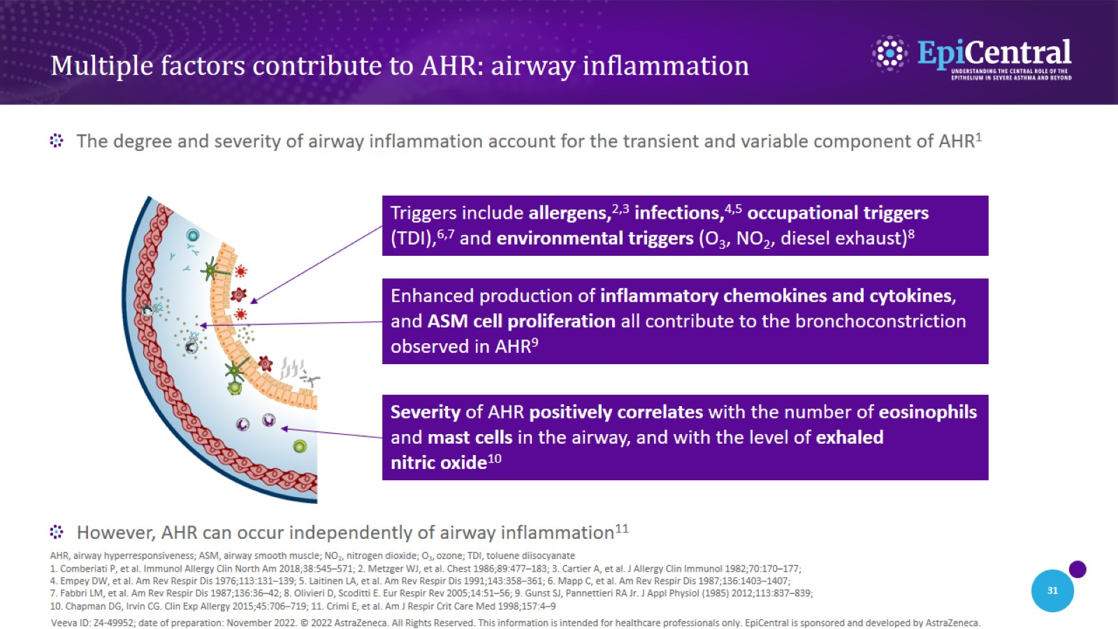
Multiple factors contribute to AHR: airway inflammation
CN-142726; date of preparation: Dec 2024. © 2025 AstraZeneca. All Rights Reserved. This information is intended for healthcare professionals only. EpiCentral is sponsored and developed by Amgen and AstraZeneca.

Slide 32
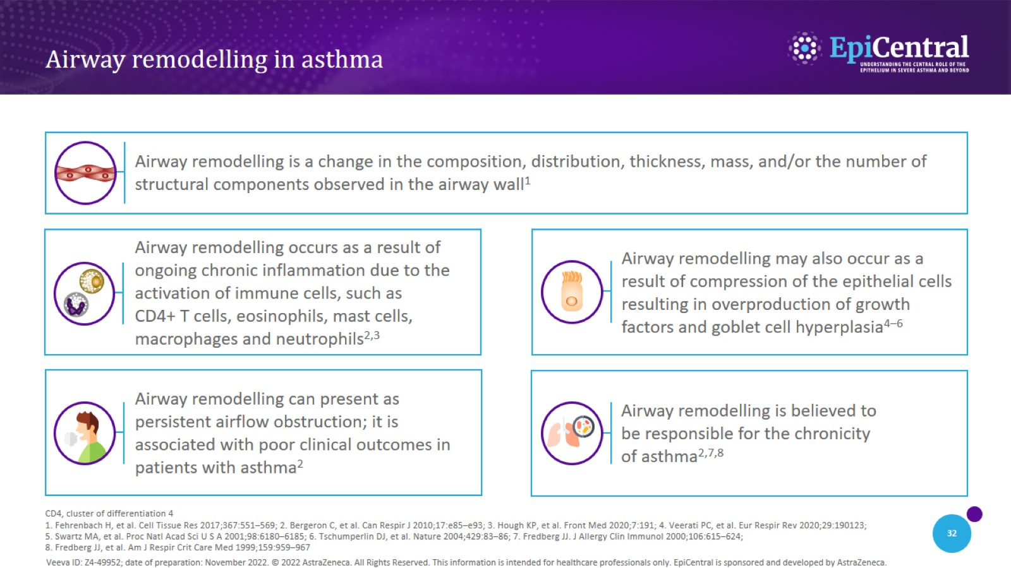
Airway remodelling in asthma
CN-142726; date of preparation: Dec 2024. © 2025 AstraZeneca. All Rights Reserved. This information is intended for healthcare professionals only. EpiCentral is sponsored and developed by Amgen and AstraZeneca.

Slide 33
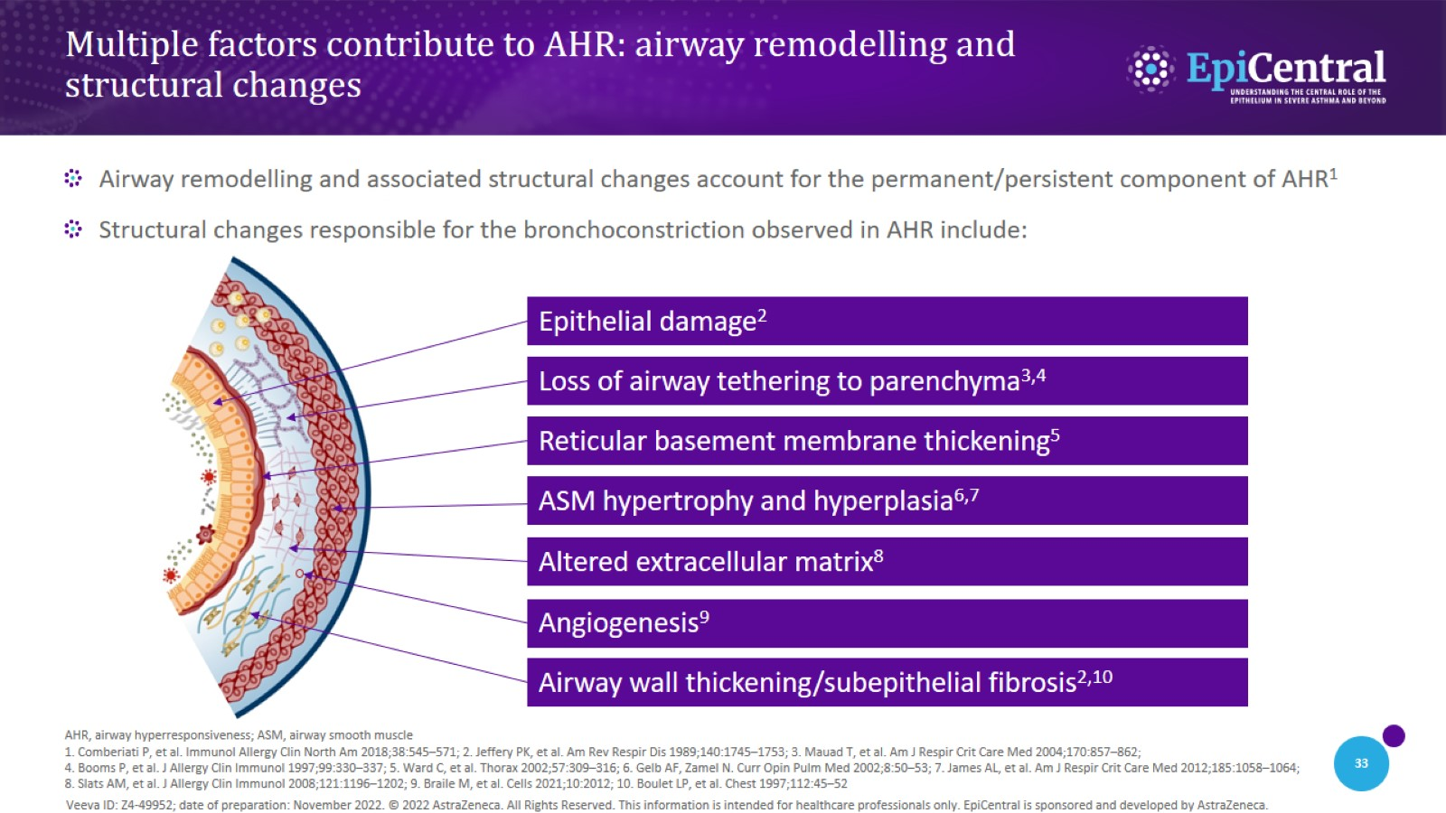
Multiple factors contribute to AHR: airway remodelling and structural changes
CN-142726; date of preparation: Dec 2024. © 2025 AstraZeneca. All Rights Reserved. This information is intended for healthcare professionals only. EpiCentral is sponsored and developed by Amgen and AstraZeneca.

Slide 34
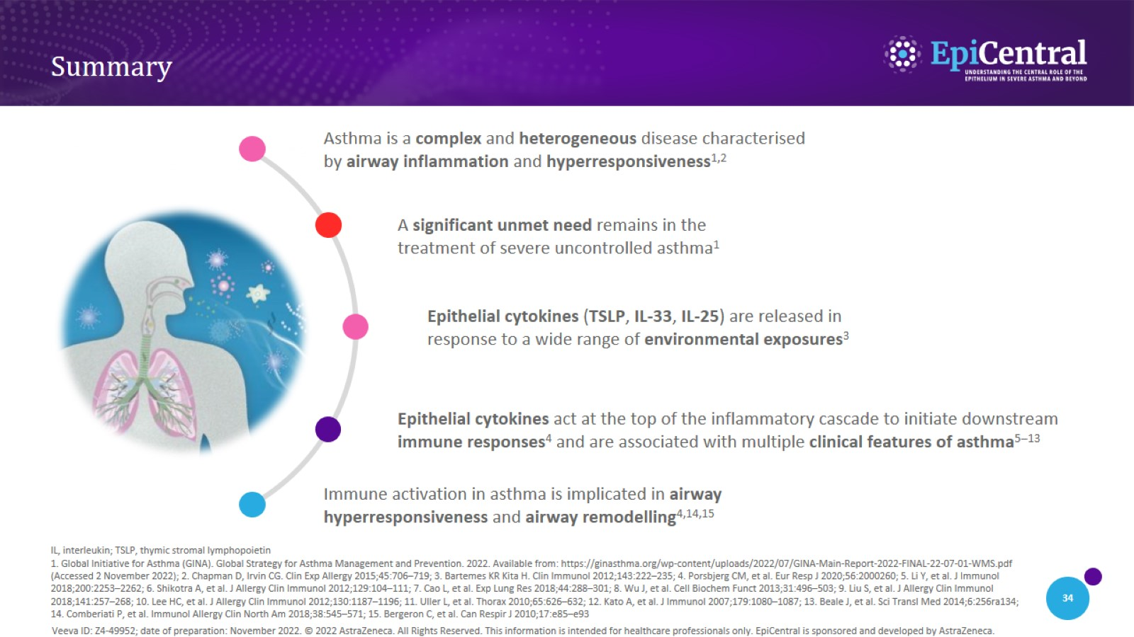
Summary
CN-142726; date of preparation: Dec 2024. © 2025 AstraZeneca. All Rights Reserved. This information is intended for healthcare professionals only. EpiCentral is sponsored and developed by Amgen and AstraZeneca.

